Slide 1
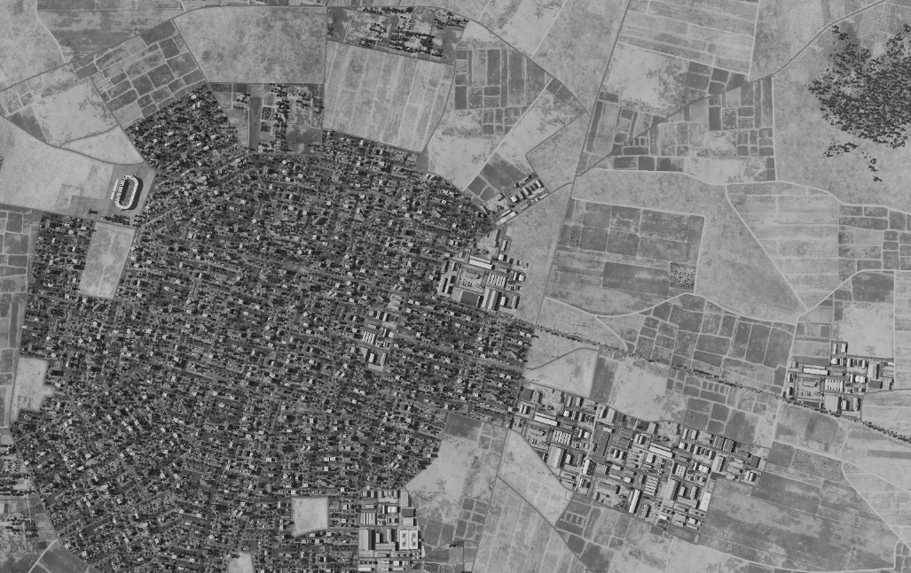
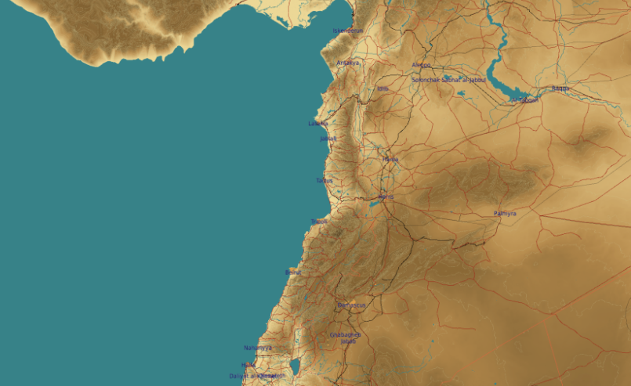
SYTGT114 Idlib Food factory
SYTGT114
N
114
Target complex consist of two production buildings.
VID assess no organic self-defense at this location however target likely protected by Syrian Army units in general defenses of Idlib.
4
5
6
Residential areas to the south. Civilian industrial buildings in immediate vicinity.
7
8

Slide 2
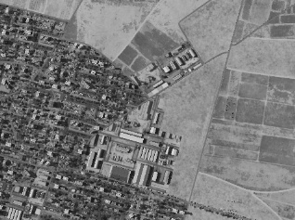
SYTGT114 Idlib Food factory
SYTGT114
114
N
Target complex consist of a two production buildings.
SYTGT114A – Production Building
N38 55.942 E036 38.723/1338ft / (1x1000 Ibs bomb)
SYTGT114B – Production Building
N35 55.941 E036 38.747/1340ft / (1x1000 Ibs bomb)
A
B
4
5
6
Residential areas to the south. Civilian industrial buildings in immediate vicinity.
7
8

